Slide 1
Tuesday, August 8, 2017
Write In Your Agenda:
Write In Your Monitoring Log:
CW:
Metric Monster Measurement
Metric Conversion Word Puzzle
HW:
Metric Monster
-final=Mon, 8/14
Response to Warm-Up:
What is the sentence that helps you remember the metric system prefixes?
You will need:
Pencil
Agenda
New Monitoring Log (pink paper)

Slide 2
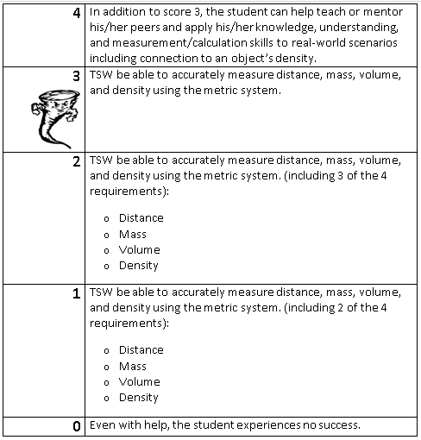
Learning Goal and Scale
TSW be able to describe how the Earth is connected to and affected by other objects in the solar system (including its movement, its relative position to other objects, its seasons, and visible constellations).

